Slide 1
Side-Channel Analysis Hardware Hacking from a Distance
Ben Janis
March 22, 2023
© 2023 THE MITRE CORPORATION. ALL RIGHTS RESERVED. Approved for public release. Distribution unlimited 22-03216-6.

Slide 2


Solving problems for a safer world
© 2020 MITRE #20-2238 8-31-2020
Notes:
Thank you for joining us today! We are excited to share with you WHO MITRE is and WHAT we do. We’re going to start off together here in the main room to learn the basics of MITRE and then we’ll head into some breakout rooms to hear about some of the cool work being done at MITRE directly from our engineers!
Without further ado, let’s dive in!
At MITRE, we’re a company of more than 8,000 innovators, deep thinkers, conveners, and problem solvers who come to work every day to tackle the complex threats facing our nation and the world.
With crises and world events unfolding in ways that nobody expects, we pivot quickly, and proactively lead in the public interest.
We know we must pioneer for a better future.

Slide 3
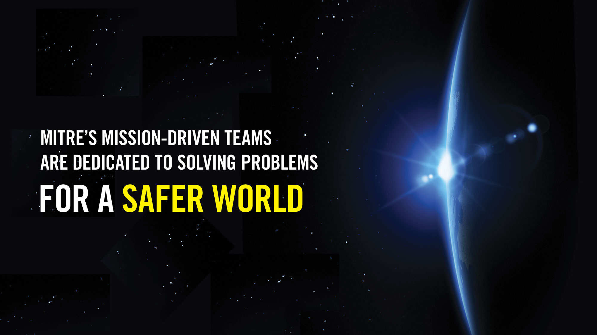

Mission: mitre's mission-driven teams are dedicated to solving problems FOR A SAFER WORLD
Notes:
What does it take to pioneer for a better future?
It takes a commitment to fostering and sparking innovative ideas and collaboration. It means we take a systems thinking approach – taking our learnings from one area or experience and apply them in new ways.
Throughout my telling you about MITRE today, I’m going to tell you some stories about a few of the big problems we are tackling. Like COVID-19, cancer, and the Great Power Competition.
These stories show how our teams are committed to solving problems for a safer world.

Slide 4

Notes:
Thanks to common data standards, we can all quickly and easily exchange information across the internet or pull money from any ATM in the world. What if we could achieve the same level of interoperability for health care—starting with cancer?
Many of the 1,500 EHR systems in use today are incompatible with one another, which dramatically limits the valuable information cancer researchers can pull from these records.
With a common standard and language for oncology, we could explore the data from millions of patients and study the myriad combinations and comparisons of treatment parameters to provide substantial insights on the best treatment for each patient. We could collect data once and share it many times—across stakeholders, including patients, providers, payors, researchers, vendors, and government agencies.
Today, alongside the American Society of Clinical Oncologists and others, we’re working to create a foundational set of cancer data elements collected from electronic health records so that every patient’s journey can improve all future care.

Slide 5

Notes:
Many companies work on big problems. At MITRE, we use our core differentiators to deliver new ways of thinking.
And you’ve heard examples of these differentiators through the stories I’ve shared:
Battling COVID
Improving cancer treatment
Protecting our economic and national security
Discovering ways to keep surface to space passage safe and viable

Slide 6
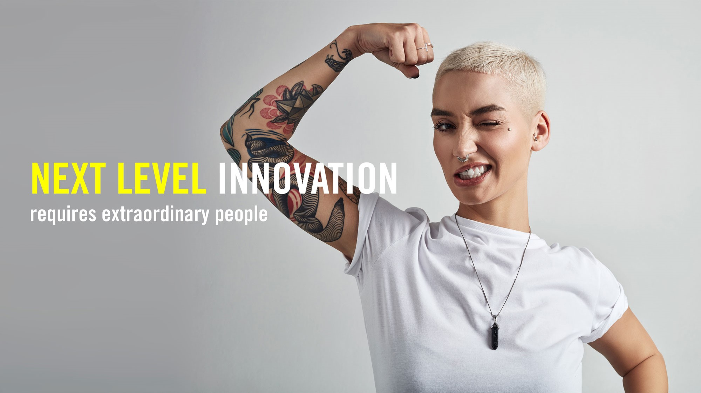
Notes:
We couldn’t do any of these things without extraordinary people.
Our engineers, clinicians, scientists, technical specialists, and researchers are at the center of all we do. They help bring our vision, mission and strategies to life.
We empower an inclusive community of innovators, learners, knowledge-sharers, and risk-takers who believe in the impossible.

Slide 7
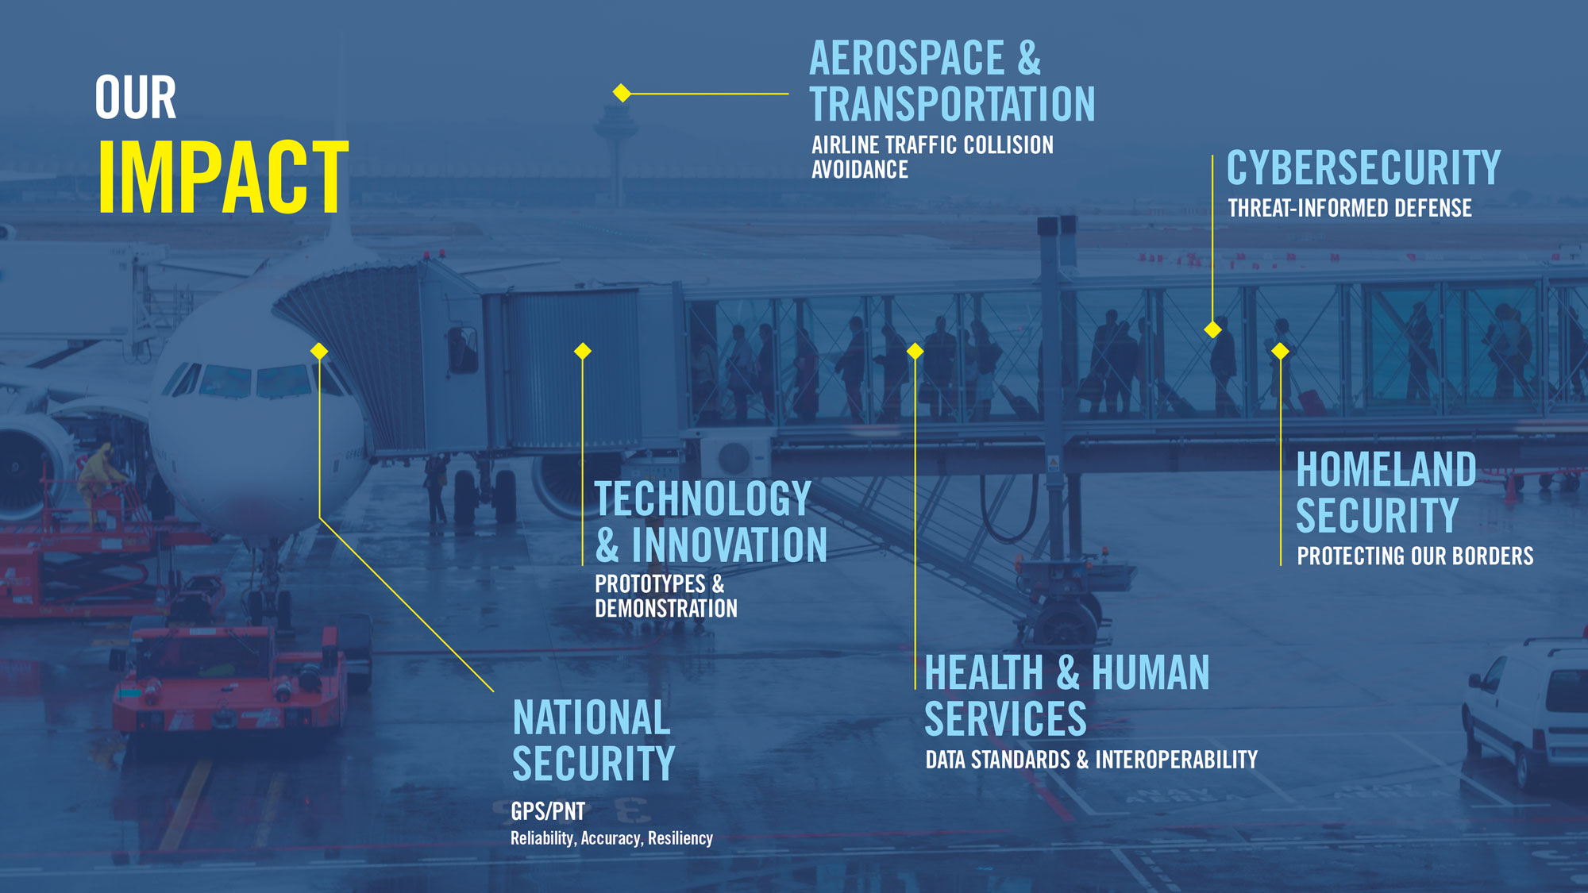
Our Impact: Aerospace & Transportation: Airline Traffic Collision Avoidance, Cybersecurity: Threat-informed Defense, Health & Human Services: Data Standards & Interoperability, Homeland Security: Protecting our borders, National Security: GPS/PNT; reliability, accuracy, resiliency, Technology & Innovation: Prototypes & Demonstration
7
Notes:
In today's complex world, there will always be a need for more evolution, more creativity, more innovation.
We strengthen the systems that protect our way of life in so many important areas.
Our world is complex. Maybe you didn’t know that MITRE’s innovations power todays GPS systems. Or that we pioneered air traffic collision avoidance systems. Or that we are working to unlock the power of electronic health records to improve patient treatment outcomes.

Slide 8

MITRE touches your life Every day
Notes:
For all of us, the world is a safer place because MITRE exists.

Slide 9
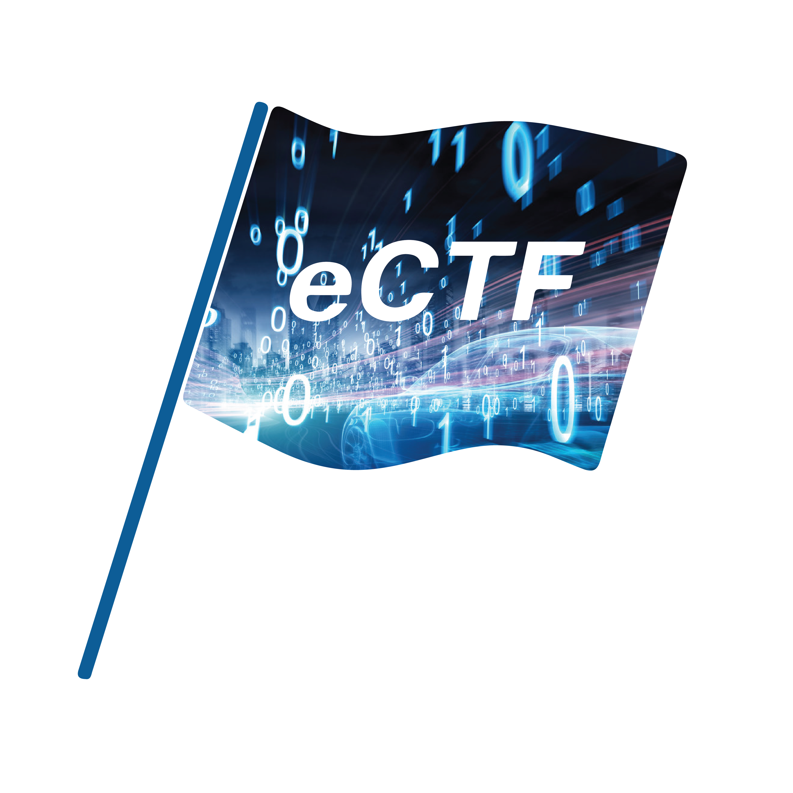
eCTF Embedded Capture the Flag
Annual embedded security competition
Teams design, build, and attack secure embedded systems
Over the spring semester
Opportunity for course credit
Excellent opportunity
© 2023 THE MITRE CORPORATION. ALL RIGHTS RESERVED. Approved for public release. Distribution unlimited 22-03216-6.

Slide 10




Unique Competition Design
Focus on Embedded
Attack and Defend
Extended Time
Physical and emulated hardware opens scope to physical and proximal attacks
Students wear both “hats” by acting as both red team and blue team
Semester-long competition opens door to advanced attacks and countermeasures
© 2023 THE MITRE CORPORATION. ALL RIGHTS RESERVED. Approved for public release. Distribution unlimited 22-03216-6.

Slide 11



Competition Phases
Design Phase
Handoff
Attack Phase
Attack Phase
Teams design and implement systems that meets security and functionality requirements
Organizers test each design for functionality
Teams analyze and attack each other’s designs for points
Analyze and attack the designs of other teams while your own design is attacked
Notes:
The eCTF is a two-phase competition.
In the design phase, students are tasked with designing and implementing a secure system on a real physical platform that meets both security and functional requirements. To help get them going, students are given a reference design that correctly exhibits all functionality without any added security.
Once students finish their design, they must pass handoff, where the eCTF organizers test their designs to verify that the system is functional.
If the system is deemed to be functionally correct, teams move into the attack phase. In the attack phase, teams gain points by compromising the security requirements of other teams’ designs and for how long their own design withstands the attacks of other teams.

Slide 12






Real-World Scenarios
Smart Door Lock
ATM Machine
Self-Driving Car
Drone Delivery
Video Game Player
Avionics

Slide 13
Why do the eCTF?
Unparalleled hands-on experience
Crypto/protocol design
Low-level C programming
Real-world offensive security
Project management
Career advancement
Looks great on a resume
Massive talent supply shortage in embedded security
It’s fun! (but a lot of work)
© 2023 THE MITRE CORPORATION. ALL RIGHTS RESERVED. Approved for public release. Distribution unlimited 22-03216-6.

Slide 14
What is a Side-Channel?
© 2023 THE MITRE CORPORATION. ALL RIGHTS RESERVED. Approved for public release. Distribution unlimited 22-03216-6.

Slide 15




Side-Channel Example: Store Backroom
By only asking employees for items in the
back and without going in yourself, figure out:
How is the backroom organized?
Where are different items located?
What shelves are items stored on?
How many items per bulk box?
Employees Only
© 2023 THE MITRE CORPORATION. ALL RIGHTS RESERVED. Approved for public release. Distribution unlimited 22-03216-6.

Slide 16
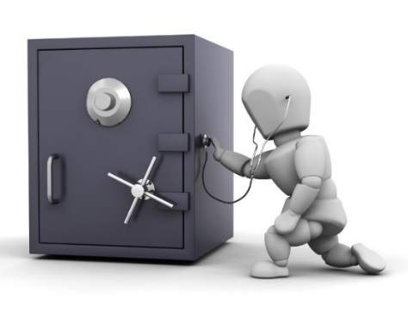
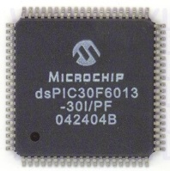
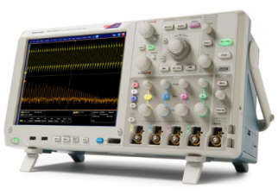
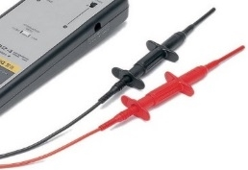
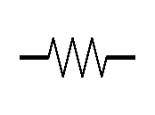
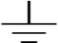
Side-Channel Analogy
Combo
Crypto Keys
Acoustic Side-Channel
Power Side-Channel
Side-channel analysis (SCA) leverage unavoidable side-effects of performing computation
© 2023 THE MITRE CORPORATION. ALL RIGHTS RESERVED. Approved for public release. Distribution unlimited 22-03216-6.

Slide 17
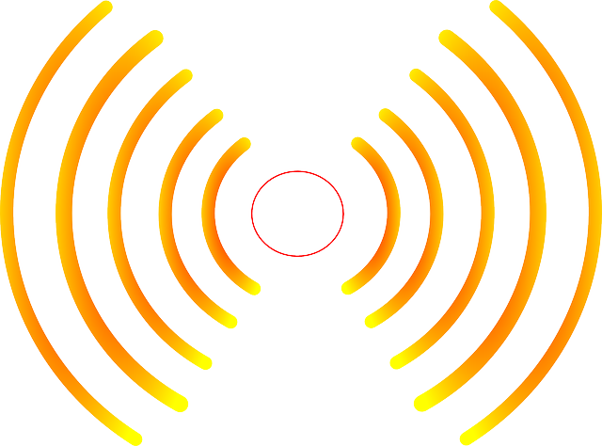

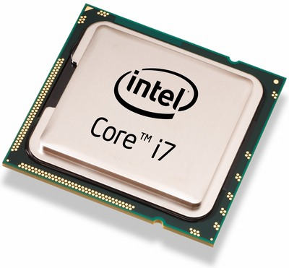

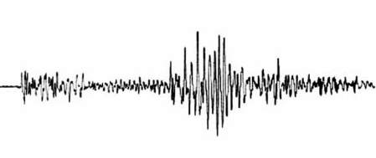
Side-Channel Attacks
SCA commonly used to:
Reverse engineer system operation
Extract information (e.g., keys)
Monitor and validate system behavior
EM Radiation
Thermal
Execution Time
Instantaneous Power
http://www.itp.net/573498-intel-core-i7-920
https://www.kisspng.com/png-light-electromagnetic-spectrum-electromagnetic-rad-1233022/
Acoustic Vibrations
https://pixabay.com/en/thermometer-temperature-rainbow-305319/
https://commons.wikimedia.org/wiki/File:Dtjohnnymonkey-Stopwatch-no-shading.svg
https://commons.wikimedia.org/wiki/File:1989_Loma_Prieta_earthquake_seismogram.jpg

Slide 18
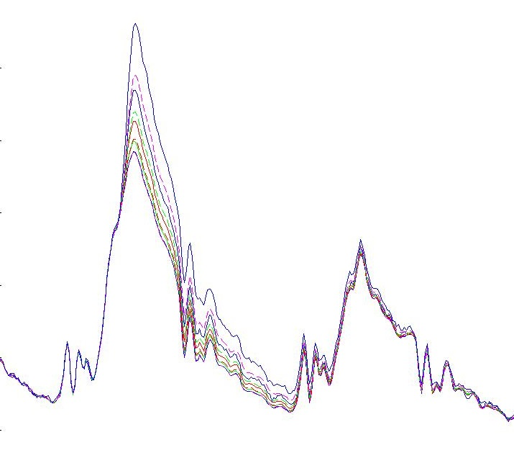
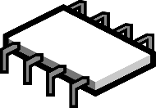
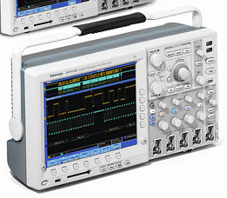
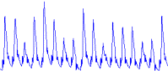

Side-Channel Capture
Side-channel leakage is captured during normal device operation
Target device is instrumented with sensors (e.g., current monitor)
Device commanded to perform its sensitive operation
Captured side-channel data is stored along with the corresponding inputs and outputs
Data-dependent power consumption
Data
Power Consumption
Photo: Tektronix Inc.
Time
Chip Image Source: https://pixabay.com/en/microchip-component-computer-chip-309407/
Battery Image Source: Tango Desktop Project
© 2018 MITRE Corporation
© 2023 THE MITRE CORPORATION. ALL RIGHTS RESERVED. Approved for public release. Distribution unlimited 22-03216-6.

Slide 19



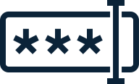
Side-Channel Workshop: PIN Lock
Scenario:
A door is secured by a smart door lock
We want to figure out the 4-digit PIN to open it
Data available to us:
Success / failure of PIN guess
Power consumption of the lock device
Knowledge that the lock uses strcmp
© 2023 THE MITRE CORPORATION. ALL RIGHTS RESERVED. Approved for public release. Distribution unlimited 22-03216-6.

Slide 20


Side-Channel Workshop: strcmp
strcmp(correct_pin, incorrect_pin)
1 2 3 4
Correct PIN:
>
1 1 1 1
Pin Guess:
© 2023 THE MITRE CORPORATION. ALL RIGHTS RESERVED. Approved for public release. Distribution unlimited 22-03216-6.

Slide 21
Side-Channel Workshop: strcmp
strcmp(correct_pin, incorrect_pin)
1 2 3 4
Correct PIN:
<
1 3 1 1
Pin Guess:
How could we exploit this?
© 2023 THE MITRE CORPORATION. ALL RIGHTS RESERVED. Approved for public release. Distribution unlimited 22-03216-6.

Slide 22
Side-Channel Workshop
https://mybinder.org/v2/gh/janisbent/sc-lab/v3.0?filepath=lab.ipynb
https://bit.ly/3ogwoQn
© 2023 THE MITRE CORPORATION. ALL RIGHTS RESERVED. Approved for public release. Distribution unlimited 22-03216-6.

Slide 23
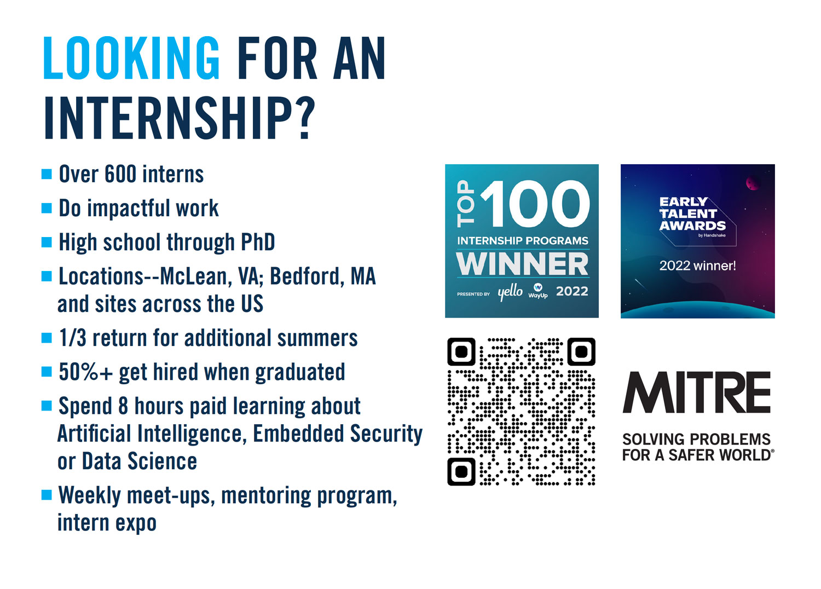
© 2023 THE MITRE CORPORATION. ALL RIGHTS RESERVED. Approved for public release. Distribution unlimited 22-03216-6.
Notes:
Included in those extraordinary people, are our summer interns & co-ops.
As a MITRE intern you can expect your work to directly impact our mission.
You’ll also have the opportunity to participate in Learning Tracks to build out knowledge in new or existing areas of interest, work with mentors, and network with each other while having fun.
Each track will journey through three phases:
Discover. Phase 1 is a presentation by a MITRE leader about the impact of MITRE's work in that area.
Create. During Phase 2, students will receive training in tools, technologies, or topics related to the track. Each curriculum may include a combination of self-paced learning, online resources, courses through the MII, staff lead classes, and “office hours” with track mentors.
Lead. In Phase 3, each track will provide a project or challenge for students to solve that builds on what they’ve learned.

Slide 24
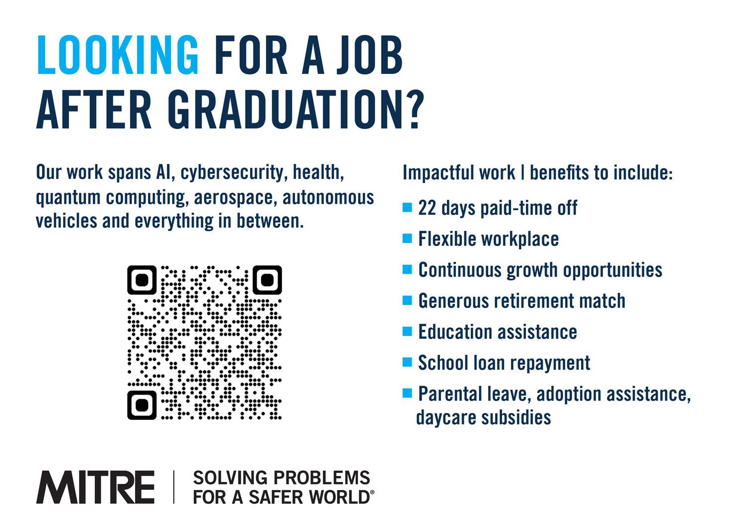
© 2023 THE MITRE CORPORATION. ALL RIGHTS RESERVED. Approved for public release. Distribution unlimited 22-03216-6.
Notes:
As new grads joining MITRE, you can expect a career filled with opportunity for professional development.
Between our inclusive culture, work/life balance including changing the way we work, where we work etc. and benefits such as:
Retirement matching,
Loan repayment assistance
Continued education
MITRE’s commitment to our early career professionals is evident.

Slide 25
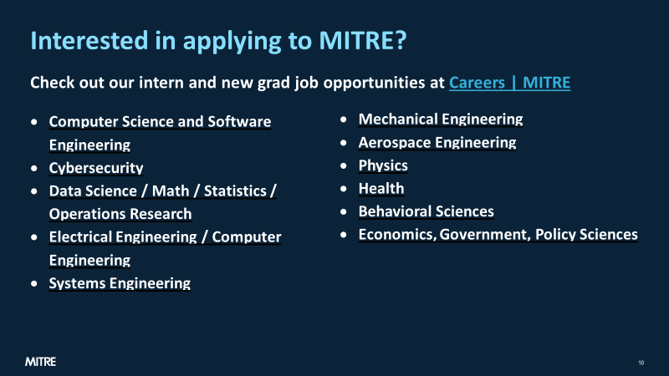
© 2023 THE MITRE CORPORATION. ALL RIGHTS RESERVED. Approved for public release. Distribution unlimited 22-03216-6.

Slide 26
Ben Janis
btjanis@mitre.org
linkedin.com/in/benjanis
© 2023 THE MITRE CORPORATION. ALL RIGHTS RESERVED. Approved for public release. Distribution unlimited 22-03216-6.

